Slide 1
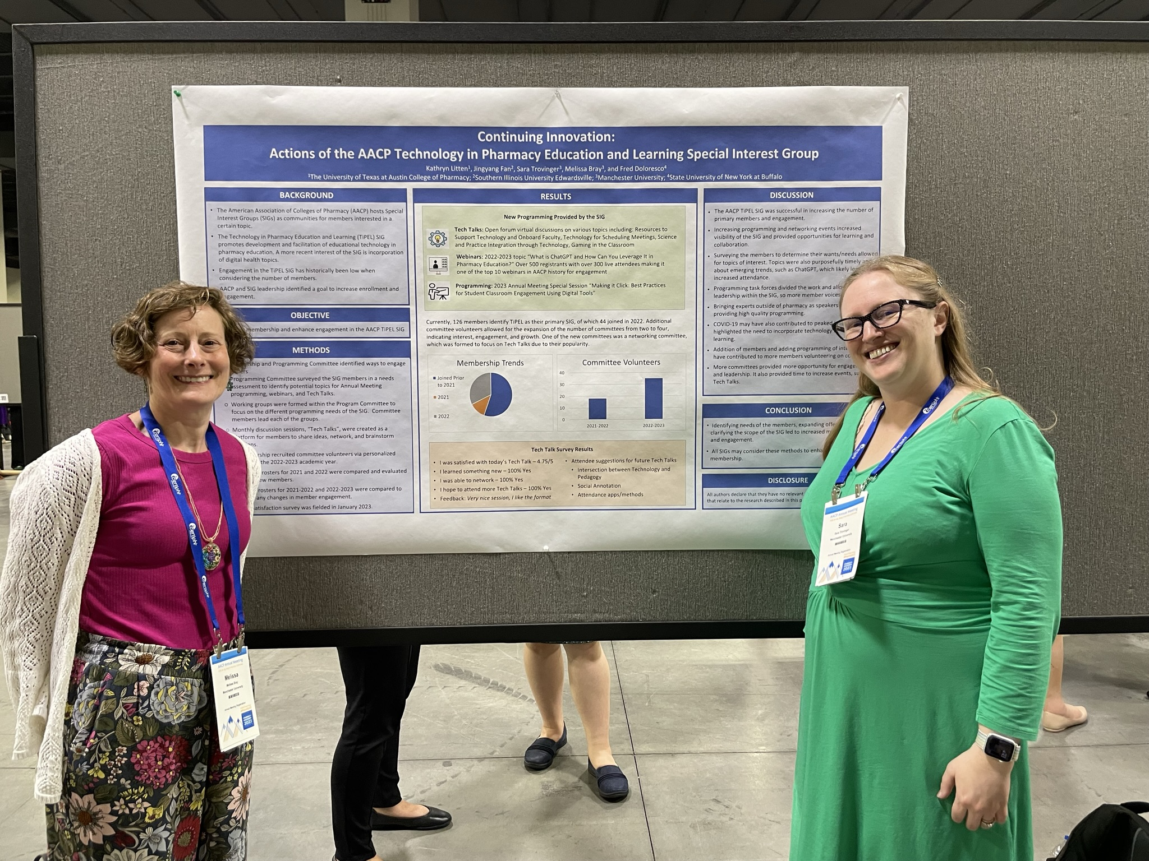
Introductions
Sara Trovinger, PharmD, MS.Ed.
Director of Distance Doctor of Pharmacy Program
Associate Director of Experiential Education
Associate Professor of Pharmacy Practice
Melissa Bray, M.Ed.
Director of Instructional Design for Health Sciences and Pharmacy Programs

Slide 2
Objectives
Discover the fundamentals of translating a face-to-face course to an online environment.
Determine effective methods for incorporating student-student, student-content, and student-instructor engagement in an online course.
Translate a portion of a current face-to-face course to an online format using one of the tools provided.

Slide 3
Why does this matter?

Slide 4
Oversight requirements

Slide 5
Step 1: Content

Slide 6
Chunking
Week by week
Focus on the essentials

Slide 7
Step 2: engagement

Slide 8
Student-Content Engagement
Videos
Readings
Assignments
Quizzes
Short
Focused
Difficult and/or most important concepts
Can be “found”
Scaffolded
Submitted
“Graded”
Multiple attempts
As or more difficult than exam questions
OER
Sections
Authentic

Slide 9
Student-Student Engagement
Discussion boards
Post and reply
Assigned roles
Assigned weeks/topics
Group projects
Authentic
Evaluate group
Evaluate individuals
Peer review
Rubric
Grade reviewer
Collaborative activities
Shared documents
Class question list
Polls

Slide 10
Student-faculty engagement
Email
Response time expectations
Office hours
Incentivize attendance
Student success system
Academic issues
Personal issues
Kudos
Feedback on assignments
Individualized
General
Student surveys
After major projects or exams
Midpoint of course
End of course

Slide 11
A few words about RSI (Regular and substantive interactions)
Graphic retrieved from Regular and Substantive Interaction (RSI) in Distance Education by UTRGV’s Center for Online Learning and Teaching Technology

Slide 12
A few words about RSI (Regular and substantive interactions)
Regular = scheduled and predictable
Direct Instruction = live, synchronous instruction (recorded lectures don't count unless they include a discussion board)
Assessments and feedback = comments on assignments (auto-grading doesn't count; neither does stating "good job")

Slide 13
A few words about RSI (Regular and substantive interactions)
Weekly, scheduled Office Hours (by appointment is not acceptable)
Group discussion boards with active faculty participation
Use the RSI Checklist for more ideas

Slide 14
handouts

Slide 15
Items to assist in the process
https://bit.ly/OnlineCoursePlanning
https://bit.ly/ActivityTranslation
https://bit.ly/CourseTranslation

Slide 16
Workload

Slide 17
Rice workload calculator
https://bit.ly/WorkloadCalculator

Slide 18
examples

Slide 19
Recitation activity
on-campus
online
2 credit hour pharmacy calculations course
1 credit hour lecture weekly
1 credit hour recitation weekly
Recitation involved students bringing difficult problems to class, and working with a partner or group to solve the problem
Faculty member would rove the classroom and solve commonly asked questions on overhead projector for whole class
Students split into groups of 4-5 students
Each student in group has a different set of two problems that they “teach” the other people in their group how to solve
Students must submit a video with both an audio and video component showing step by step how to complete both problems
Students can view the videos from others in their group
Instructor or TA give personalized feedback weekly on the videos

Slide 20
Group Activity + Poll
On-campus
online
Think-pair-share followed by poll questions related to a mini-case or course content
Small group discussion board with mini-case or content links and open-ended questions followed by an individual, no-stakes/low-stakes quiz with case questions that would have been in polls

Slide 21
Group Discussion
On-campus
online
Small group discussion of a case and completion of a group assignment, such as a care plan or business plan
Small group discussion board with case and separate assignment templates provided for each group linked in OneDrive, which will be submitted to a group assignment in the LMS once completed

Slide 22
Socratic method
On-campus
online
Socratic method or inquiry-based questions asked throughout a lecture
Quiz questions embedded in lecture video (can be multiple choice or open-ended)
OR have students leave comments/questions on your recording
OR have students take notes on your recording and then submit to an assignment.

Slide 23
Peer instruction
On-campus
online
Peer instruction activity with lecture
Post textbook chapter, handout, or lecture slides to as an annotation activity and have students annotate the document with questions, comments, and so many required responses to each other

Slide 24
Questions?

